Slide 1
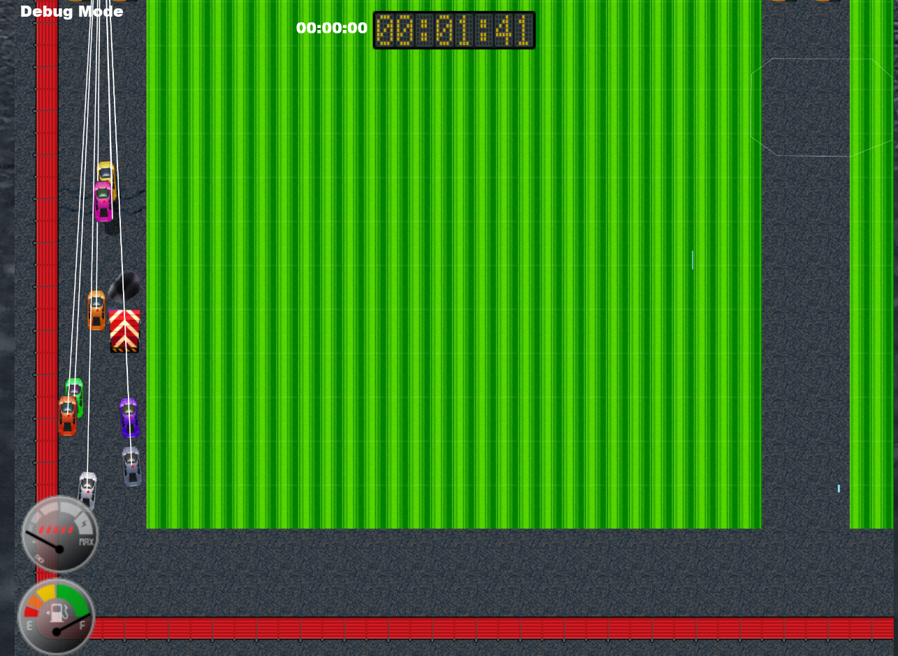
Little Racers
Pitch Date: June 22 , 2019 Week 6: 8/4/2019
Release Date: September 15, 2019 6 weeks to go!
Team Lead: Vince McKeown
19 contributors (+2)

Slide 2
Updates to Code
Mike LeSauvage
Ramp Improvements. Cars can travel down ramps, or travel backwards
Oil improvements. Low speeds allow for some steering
Simon
Cam shakes when crack tile is driven over
Speed is affected when driving over crack on road
Fixed camera shake if car is station on cracked tile
Adgemon
Minimap started

Slide 3
Updates to Code
Baris Koklu
x
Christer “McFunky Pants” Kaitila
Cracks detected in collision code
Anthony Free
Reversing doesn’t cause fuel consumption
Bug fixed: Winner announced for each race
Bug fixed: Car needs to be traveling at a certain speed for oil effect
H Trayford
Canvas on resizes when the window changes sizes
Added Lake Tiles to the collision detection
AI car draves slightly different position to each way point.

Slide 4
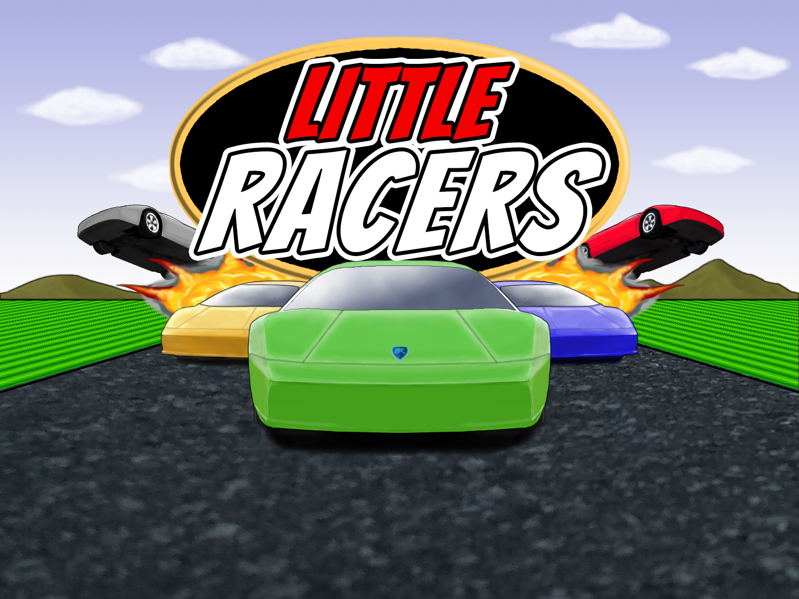
Updates to Art
Jeff Hanlon

Slide 5
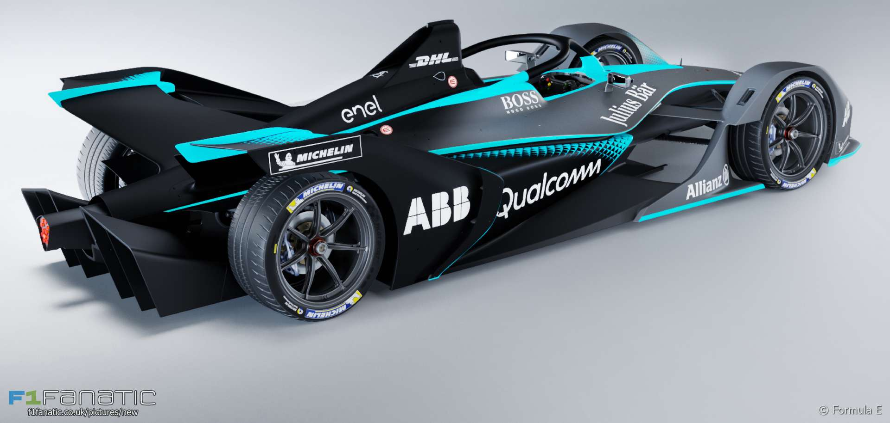
Demo
Cutover to Game

